Slide 1
Binary and Floating Point Arithmetic
What is covered
Appendix A: Binary Numbers (P 631-643)
Appendix B: Floating-Point Numbers (P 643-653)

Slide 2
Contents
Finite Precision Numbers
Radix Number System
Conversion from One Radix to Another
Negative Binary Numbers
Binary Arithmetic
Principles of Floating Point Numbers
IEEE Floating Point Standard 754

Slide 3
Finite Precision Numbers
In arithmetic, no attention is paid to the amount of memory taken to store numbers.
Computers have finite memory, hence memory matters – need a representation
Algebra differs in finite precision arithmetic.
  Closure violated due to overflow and underflow
  Density lost in case of real and rational numbers

Slide 4
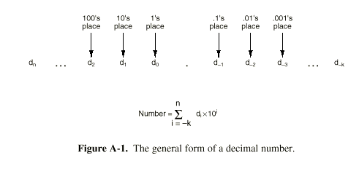
Radix Number System
Base 10 Example

Slide 5
Requires k different symbols to represent digits digits 0 through k-1.
Decimal Numbers: (Base 10)
  Built from 0,1,2,3,4,5,6,7,8,9
Binary Numbers: (Base 2)
  Built from 0,1
Octal numbers: (Base 8)
  Built from 0,1,2,3,4,5,6,7
Hexadecimal numbers: (Base 16)
  Built from 0,1,2,3,4,5,6,7,8,9,A,B,C,D,E,F

Slide 6
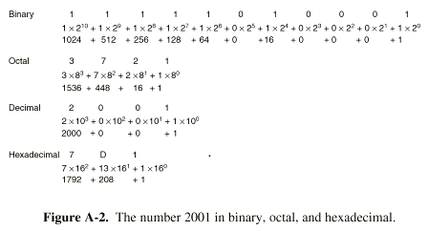
Examples

Slide 7
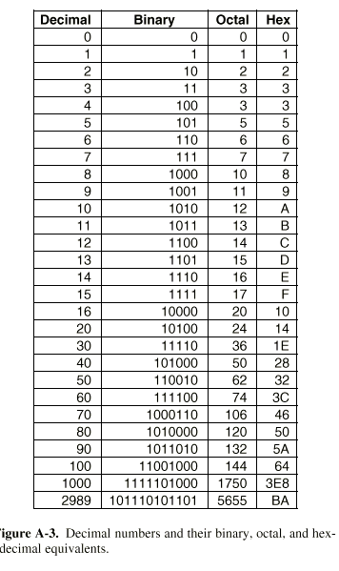

Slide 8
Conversion from One Radix to Another
Octal <-> Hexadecimal <-> Binary
  Easy
  Binary to Octal:
    Divide into groups of three bits –starting from immediate left (and right) of the decimal point
    Convert each group into octal from 0 to 7.
    Example:
        Binary 1010111.011
        Octal 127.3
    May be necessary to add leading or trailing zeros to form groups of three
  Hexadecimal <-> Octal, Binary – Same procedure

Slide 9
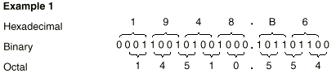
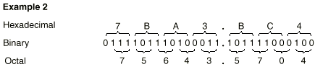
More Examples

Slide 10
Decimal to Binary: First Method
Take the largest power of 2 that divides the number and subtract that amount
Repeat process
Example: Decimal 22
  Largest exponent of 2 is 4. I.e. 16
  22 –16 = 6
  6 = 4+2
  Hence Binary number is 10110
  I.e. 2**4 + 2**2 + 2**1

Slide 11
Decimal to Binary
Second Method (Integers only)
Divide the number by 2
  Quotient written directly under original number
  Remainder written next to quotient
Repeat process until 0 is reached
Directly use Euclidean Algorithm

Slide 12
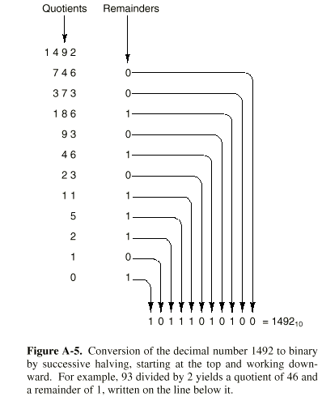
Example

Slide 13
Binary to Decimal
Method 1- Sum up powers of 2
  Example: 10110 is 2**4 + 2**2 + 2**1 = 22
Method 2: Successive doubling
  Write the binary number vertically
  Lines are numbered from bottom to top.
  Put 1 on line 1 (bottom)
  Entry on line n = 2*(entry on line n-1) + bit on line n (0 or 1)

Slide 14
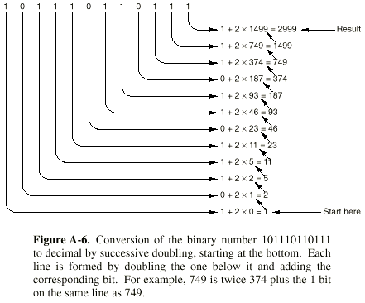
Example

Slide 15
Negative Binary Numbers
Signed Magnitude: Leftmost bit has sign (0 is +, 1 is -)
One’s Complement: To negate a number switch all 0’s and 1’s (including sign bit) Obsolete now.
  Example: 00000110 (+6)
  (-6 in ones complement) 11111001

Slide 16
Negative Binary Numbers
Two’s Complement: (Has sign bit 0 for + and 1 for -)
Negating a number:
  Switch 0’s and 1’s (as in one’s complement)
  Add 1 to the result
Example 00000110 (+6)
  (-6 in one;’s complement) 11111001
  (-6 in two’s complement) 11111010
  Any carry over from leftmost bit is thrown away

Slide 17
Negative Binary Numbers
Excess 2**(m-1): Represents a number by (number) + 2**(m-1)
Example: For 8-bit numbers –3 is
–3+127 = 125 in binary is 01111101
Numbers from –128 to +127 mapped to 0 to 255, expressible as 8 bit positive integers
Identical to two’s complement with sign bit reversed

Slide 18
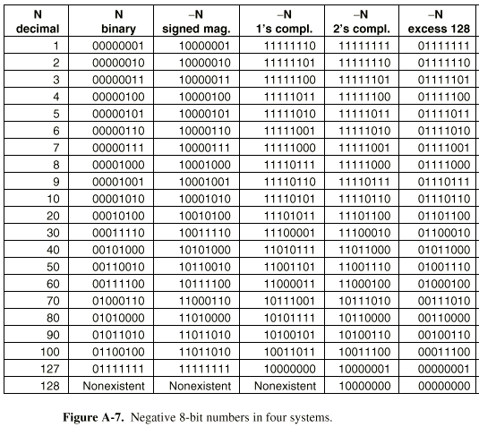

Slide 19
Some Properties of Negative Numbers
Signed magnitude and one’s complement has two representatives for zero (+0 and –0)
Two’s complement has only one zero
Problem with two’s complement
negative of 100000 = 100000
What is desired:
  Only one representation for zero
  Exactly the same number of + and – numbers
  Need to have an odd count if this is to be achieved.

Slide 20
Binary Arithmetic
Two binary (octal, hexadecimal) numbers can be added just as decimal numbers
The carry need to be taken to the next position (left)
In one’s complement, carry generated by the leftmost bit is added to the rightmost bit.
In two’s complement, carry generated by the leftmost bit is thrown away

Slide 21
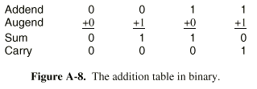
Binary Arithmetic

Slide 22
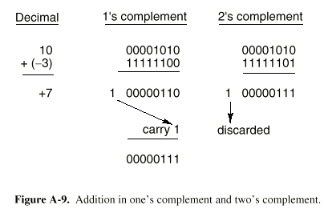
Examples of Binary Arithmetic

Slide 23
Overflow
If addend and augend are of opposite sides no overflow occurs
If both are of same sign, result is opposite sign, overflow occurs
In both one’s and two’s complement overflow occurs iff carry into sign bit differs from carry out of sign bit
Most machines have overflow bit

Slide 24
Floating Point Arithmetic
Two Important issues in representing real (floating point) numbers:
  Range: The length of the interval
  Precision: What small differences can be shown
N = f* (10**e)
  Fraction = f: Number of digits here determines precision
  Exponent = e : Determines the range
Example: 3.14 = 0.314 * (10**1)

Slide 25
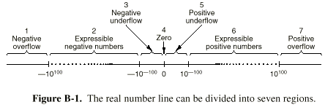
Two digit exponent and signed three digit fraction
Range +0.100*(10**-99) to +.999*(10+99)

Slide 26
Overflow, Underflow
Regions 1 and 7 represents overflows – answer incorrect
Regions 3 and 5 represents underflow errors –less serious than overflow errors
Problems with Floating Point Numbers:
  No density
  Do not form a continumm
  Spacing between two consecutive numbers not constant throughout regions. I.e separation between
  +0.998* (10**98) and +0.999* (10**98) vastly different from +0.998* (10**0) and +0.999* (10**0)

Slide 27
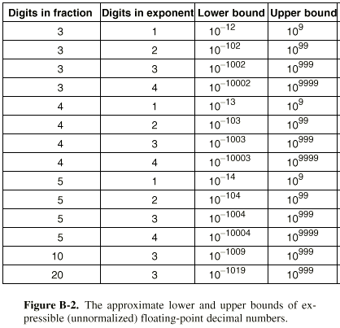

Slide 28
Normalized Digits
Shifting the number of digits between exponents and fraction shifts boundaries of regions 2 and 6.
Increasing number of digits in fraction increases density – thus improves accuracy
Increasing size of exponent increases regions 2 and 6, by shrinking others.
In computers:
  Base 2,4, 8 or 16
  If leftmost digit is zero shift one place left and decrease exponent by 1
  A fraction with nonzero leftmost digit is said to be normalized.

Slide 29
Normalized Digits
Normalized Digits:
  There is only one normalized expression, whereas there can be more than one non-normalized floating point expressions.
Example next slide

Slide 30
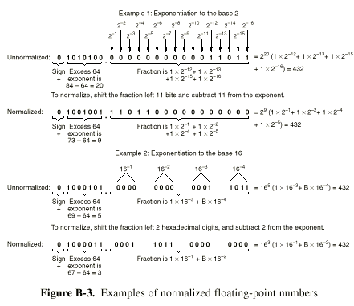

Slide 31
IEEE Standard 754
Designed by William Kahan of UCB
Three representations:
  Single Precision: 32 bits
  Double Precision: 64 bits
  Extended Precision: 80 bits
Both Single and Double precision uses
  Radix2 for fractions end excess notation for exponents
  Starts with sign bits (0 for +, 1 for -)

Slide 32
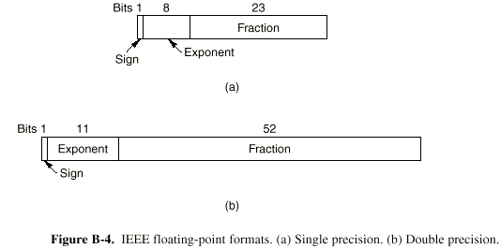

Slide 33
Normal Fractions, Examples
Normal Fraction:
  Decimal point,
  1
  Other numbers
  Omit 1 to begin with (implied)
  Omit binary point (implied)
  Either 23 or 52 fraction bits: If all 0 then fraction 1.0
  If all 1, then fraction taken to be 2.0 (slightly less)
Example
  0.5 = 3F000000
  1 = 3F800000
  1.5 3FC00000

Slide 34
Dealing with Underflow I
If calculation results in a number smaller than the smallest representable:Use Denormalized Numbers
Have exponent zero, and fraction given by 23 or 52 bits
These have bit left of decimal as 0
The smallest denormalized number has 1 as exponent and 0 as fraction = 1.0 *(2**-127)
The largest denormalized number has 0 as exponent and all 1’s = 1.0 *(2**-127)

Slide 35
Dealing with Underflow II
As numbers go further down, first few bits become zero:
  exponent represents 2**(-127), and
  fraction representing 2**(-23)
  So the number represents 2**(-150)
Gives graceful underfull without jumping to zero
Two zeros are present, with fraction 0 and exponent 0

Slide 36
Dealing with Overflow
There are no bits to represent overflow
Represent infinity with
  exponent with all 1’s
  Fraction 0
  Not a normalized number
Behaves like mathematical infinity
Infinity/Infinity cannot be determined, represented by NaN

Slide 37
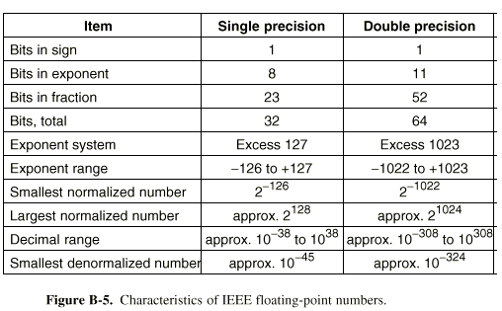

Slide 38
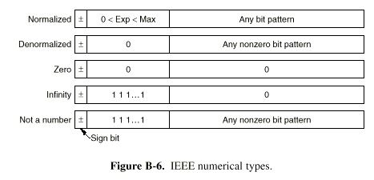

Slide 39
Error Correcting Codes
Due to occasional errors of voltage fluctuations, can cause bit errors
To prevent these errors, some memories and networks use error correcting and error detecting codes.
Memory word of n bits has m data bits and r check bits for error checking/correcting

Slide 40
Hamming Distance
How many bits differ: Take exclusive or:
Example 10001001 and 10110001, EXOR reveals three bit error.
Hamming Distance: The distance in which two code words differ.
If two code words are a hamming distance apart, it will take d single bit errors to convert one to the other.

Slide 41
Correcting vs. Detecting
Error Detecting Codes: To detect d single bit errors need distance d+1 apart codes
To correct d single bit errors, need 2d+1 distance apart code words.
Parity Bit: Takes two errors to go from one correct word to another.
M data and r check bits allows 2**m legal memory words, has n illegal word with distance 1, thus each word has n+1 words dedicated to it. Since total bit patters is 2**n So we get
m+r+1 < 2**r, Given m we get a lower bound for r.

Slide 42
